Slide 1
Endpoints Operations
Monthly Operations Summary
JL IT
March 2023

Slide 2
Executive Summary
Incident Management Summary
Service Desk Summary
Technology Operations Summary
Endpoint Engineering Summary

Slide 3
Executive Summary
Incident Management saw incident volume rise in March (3593). The first call resolution, or FCR, was 89.6%. The overall SLA goal across all teams was met at 91.8%.
Service Desk call volume remained steady at 2912 calls in March. Calls answered within 30-, 60-, and 90- seconds goals were surpassed. Average speed to answer was very low at 25 seconds. The abandonment rate goal for the month was also surpassed at 5.05%. SLA goals were met by the Service Desk with an overall SLA score of 97.9%.
Technology Operations 22% increase in escalated tickets coming to Tech Ops from the previous month. Escalated tickets to engineers remain the same with most tickets going to Marion Thomas for NetDocs. 80% increase in logic monitor alerts due to mostly status/idle interval on network equipment. Investigating to further finetune threshold to reduce false positive of polling the network devices. Website Monitoring with 3 sites dropping from 99% due to authentication changes and DR testing with Biscom.
Endpoint Engineering End of March saw both Netdocs Suite 3.1.0 and Litera Suite close to 100% in production. Internet Explorer 11 Removal is close to 100% firmwide as is the latest M365 Semi-annual Office Update channel, helping Rapid7s vulnerabilities. Issues found with auto-enrollment cert profile are being corrected allowing for dormant agents to heal and rejoin our fleet. New products currently being tested Zscaler, 8x8 and KnowBe4 Phishing Protection with success and hopes of moving to Pilot/Prod in April 2023.

Slide 4
Incident Management

Slide 5
Incident Statistics
3,593 incidents were opened during the month, across all groups within SNOW. 24% of incident volume was email, while seeing a higher volume of phishing reported to the Service Desk.
Phone: 2602
Email: 863
Self-Service: 82
Walk-in: 45
Chat: 1
First contact resolution rose to 89.6% in March. (as opposed to 85% in February).

Slide 6
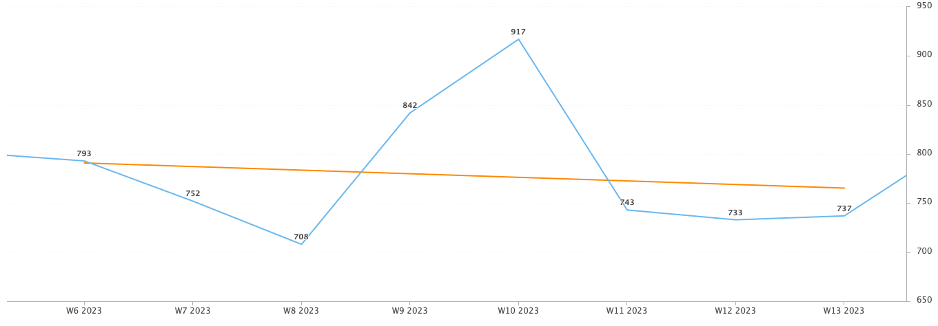
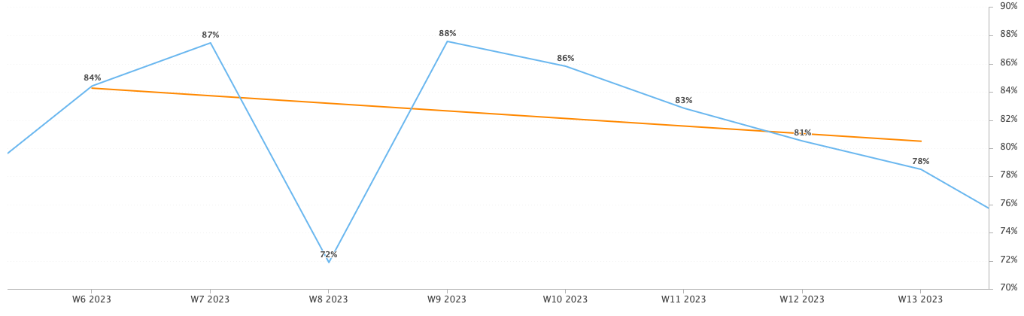
Incident Statistics
Incidents Opened by Week
Incidents opened by week trended downward over the last two months.
Week 10, or March 5th through 11th saw a high point for incidents opened. This week saw the start of the Phishing Campaign by Security. This included 147 reports.
The percentage of incidents resolved the same day that they were opened began to trend downward in March.
The incidents opened remained steady (specifically week 11,12, & 13) while this occurred.
Percentage of incidents resolved; same day opened.

Slide 7
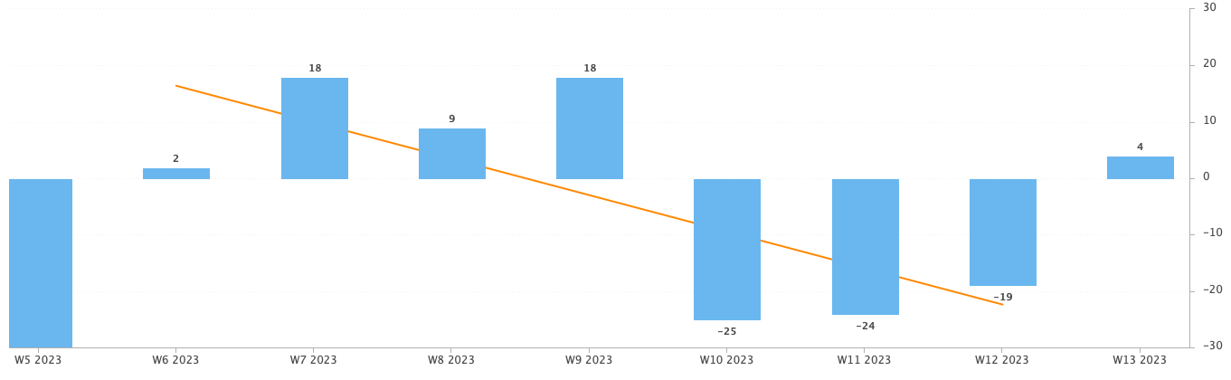
Incident Statistics
Open Incident Backlog Growth
Backlog growth declined across March.
Notes:
Backlog growth is a way of answering, “did we end the week with more or less incidents?”.

Slide 8
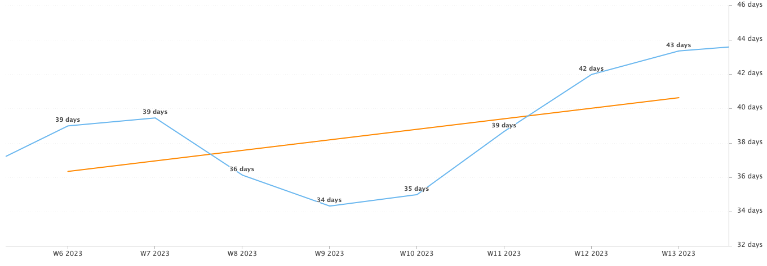
Incident Statistics
Average Age of Open Incidents
In March, the average age of open incidents increased.
Notes:
Please remind your teams to continue to work on their open incidents- this affects many of the previous slides as well as this one.

Slide 9
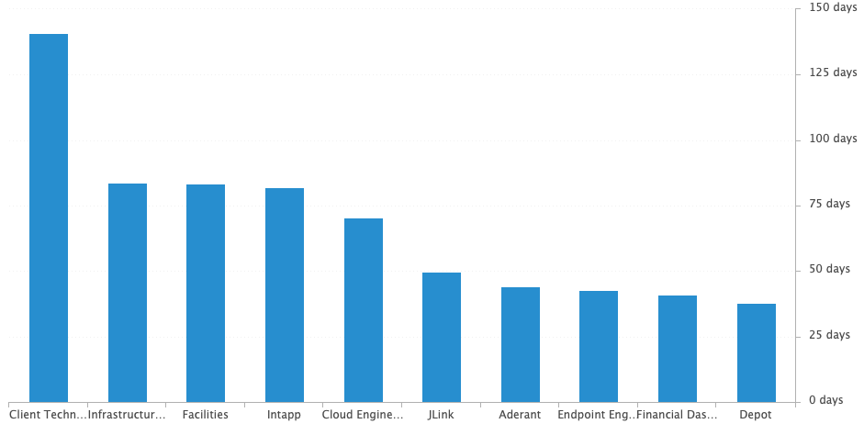
Incident Statistics
Average Age of Open Incidents by Assignment Group - as of the last day of the month

Slide 10
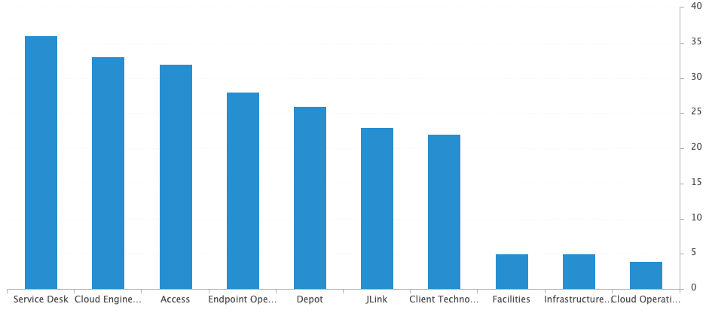
Incident Statistics
Open Incidents by Assignment Group - as of the last day of the month
There are currently 259 open incidents across all teams.

Slide 11
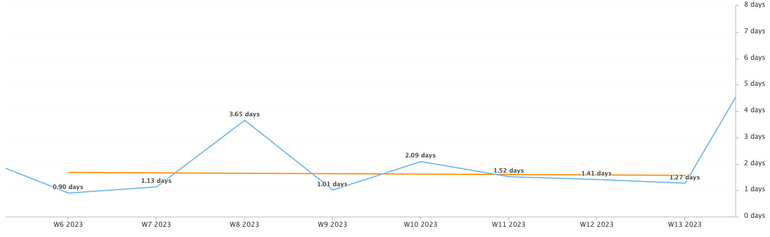
Incident Statistics
Average Resolution Time of All Resolved Incidents
The average resolution time trended downward across the last two months.

Slide 12
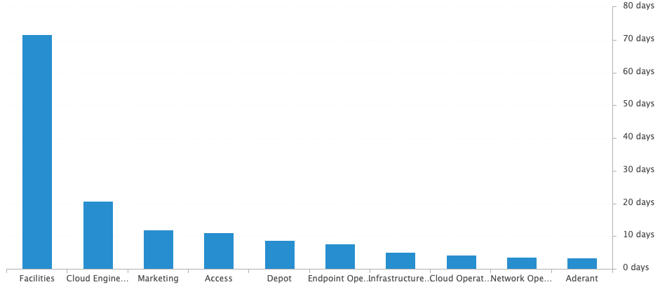
Incident Statistics
Average Resolution Time of Resolved Incidents, by Assignment Group

Slide 13
Incident Statistics
Top 5 Subcategories this month:
Microsoft Office (673)
NetDocuments (368)
Windows (212)
Report Phish (199)
Add-ins (194)
Top 5 Resolved By this month:
(highest volume of resolved Incidents)
Dan (566)
Blaise (344)
Brandon (335)
Stephane (318)
Marcus (282)
Top 5 Assignment Groups (Tier 2) this month:
Endpoint Operations (188)
Cloud Operations (107)
Access (69)
Telco Operations (47)
Infrastructure Operations (22)
Top 5 Assignment Groups (Tier 3) this month:
Cloud Engineering (69)
Security (47)
Intapp (11)
Jlink (8)
Aderant (5)

Slide 14
Incident Statistics
Top 10 Customers this month:
Kyle Woodward (24)
Nancy Betchelder (22)
Craig Wiley (20)
Pedro Forment (20)
Jan Godek (19)
Beth Davis (18)
Greisy Ledo (18)
Mary Irwin (17)
Olivia Cohen (17)
Joyce Buller (15)
Notes:
Across the month _had the highest number of related incidents.
Top 5 customers in the month are listed here.
Looking at the chart, we’re tracking incident volume per new-hire per month and comparing this to last year.

Slide 15
2022 SLA Goals & Actuals
Month | January | February | March | April | May | June | July | Aug | Sept | Oct | Nov | Dec
Goal | 90% | 90% | 90% | 90% | 90% | 90% | 90% | 90% | 90% | 90% | 90% | 90%
Actual | 91.9% | 92.38% | 91.8%
SLA score for last year was 90.85%.
The Incident SLA goal was met in March.

Slide 16
Problem Statistics
Open Problems
Problem | Date of most recent update | Assignment Group
PRB0010189 | 2023-01-10 | Cloud Engineering
PRB0010587 | 2023-01-12 | Cloud Engineering
PRB0010598 | 2023-03-28 | Security
PRB0010606 | 2023-03-17 | Endpoint Operations
PRB0010634 | 2023-03-06 | Endpoint Engineering
PRB0010657 | 2023-04-03 | Cloud Engineering
PRB0010673 | 2023-03-08 | Endpoint Engineering
PRB0010677 | 2023-03-08 | Endpoint Engineering
PRB0010678 | 2023-03-16 | Client Technology
PRB0010679 | 2023-03-17 | Cloud Engineering
PRB0010680 | 2023-03-02 | Cloud Engineering
PRB0010700 | 2023-04-10 | Infrastructure Engineering
PRB0010702 | 2023-03-27 | Security
PRB0010706 | 2023-04-10 | Cloud Engineering
Note that 13 of the 17 PRB opened were created for tracking active risks.

Slide 17
Risk Management
Problem | Title | Date of most recent update | Assignment Group
PRB0010687 | RISK: MacBook Not Enforcing DLP (Encryption) on USB Drives nor allowing us to shut off USB Ports | 2023-03-31 | Security
PRB0010689 | RISK: Data Governance | 2023-03-27 | Security
PRB0010691 | RISK: Social Media Credentials Not Securely Stored | 2023-03-17 | Security
PRB0010693 | RISK: Built-in Administrator account is not disabled | 2023-03-21 | Intapp
PRB0010694 | RISK: DG: Weak Access Restrictions for Sensitive Data | 2023-03-27 | Security
PRB0010695 | RISK: Shiny.IO | 2023-03-17 | Data Science
PRB0010696 | RISK: Non-compliance of Electronic and Paper Engagement Closeout Requirements | 2023-03-17 | Security
PRB0010697 | RISK: DG: Regulatory Compliance/and or Requirements | 2023-03-27 | Security
PRB0010705 | RISK: Lack of Application Inventory | 2023-04-05 | Cloud Engineering
While likely reported within Security summaries, their team are now tracking multiple risks as Problems within Service Now.

Slide 18
Service Desk

Slide 19
Year over Year Quarterly Results

Slide 20
Key Call Statistics
Call volume remained steady from the previous month with 2912 calls in March.
The goal was surpassed at 5.05%.
The abandonment rate monthly goal in 2022 was 9%. We’ve ambitiously lowered the ceiling of the goal to 8% for 2023.
Notes:
~
There are several stats tracked for individual analysts as well as for the team and the org. Across the next few slides I’ll highlight some key statistics for the Service Desk team.

Slide 21
Key Call Statistics
The Service Desk met all 3 goals for each range. This correlates with the call volume and abandonment rates.
The goals for each time period:
70% of calls handled within 30 seconds.
75% of calls handled within 60 seconds.
80% of calls handled within 90 seconds.
Notes:
Over 75% of calls were handled within 30 seconds.
Over 80% were handled within 60 seconds.
Over 83% were handled within 90 seconds.
~
We track multiple metrics for calls handled- or how quickly a call is answered- within specific time periods. I’ve highlighted three here, calls handled within 30, 60, and 90 seconds.
The takeaway from these numbers should be that we are answering calls quickly which prevents calls from abandoning. Typically, we see the abandoned calls rise when these goals are not met- specifically the 60 seconds metric.

Slide 22
Key Call & Knowledge Statistics
The average speed to answer was very low at 25 seconds.
Notes:
~
Average speed to answer is the average of how quickly all calls were answered by the Service Desk for the month.

Slide 23
Incident Statistics
Closed Monthly Data:
Incidents closed by SD: 3,123
Total Closed Incidents: 3,781
Closed by SD Percentage: 82.6%
Incidents closed by Service Desk, by Source:
Phone: 2367
Email: 679
Self-Service: 49
Walk-in: 28
Notes:
~
The typical methods for contacting the Service Desk are phone and email, which explains the results in the incident source chart.
Self-Service we hope to expand over the next year and drive users towards generating their own incidents and using the JL Service Center more actively.
Walk-ins are low month-to-month with the split schedule for Return to Better. But from analyst feedback incidents for walk-ins are not being opened consistently. I aim to correct this over the rest of this year. I’ve also added it as a 2022 goal for each analyst within their reviews.

Slide 24

2021 Service Desk SLA Statistics
Survey Response Comment Highlights:
Dan - As always, excellent.
Marcus, Chris, and Stephane have helped me so much with my extranet issues. They each provided me with very helpful and efficient guidance. I am very grateful!
Dan was super quick, super helpful, super easy to work with!
Chris - We have an AWESOME IT Team!!! Thank you!!!
Stephane - The staff expedited a new distribution list for us, delivering way before the usual turnaround time for such requests, so that we could quickly get an email out to the list members. We were very appreciative!
Chris is always very responsive and cheerfully helps me solve my IT problems.
Brandon - Always Awesome!!! Thank You!!
Dan & Danae - Our IT people are the best!
Taylor - Always the best service with our IT Team.
Stephane is always a delight to work with and always solves the problem. He is a real asset to the firm.
September | Breached | Has not Breached | SLA %
Response | 96 | 3032 | 96.84%
Resolution | 29 | 3099 | 99.06%
Overall | 125 | 6131 | 97.96%
Response & Resolution SLA timers are determined by the Priority of the Incident.
Both Response and Resolution SLA reviewed on this slide are across all Priorities.
Notes:
Service level agreements/SLA
Response & Resolution SLA timers are determined by the Priority of the Incident.
Both Response and Resolution SLA reviewed on this slide are across all Priorities.
~
The Service Desk team is uniquely prepared to meet SLA goals. We generate incidents during calls, while emails generate their own incidents.

Slide 25
Update & Reminder Highlights
Escalation: A reminder that we should be escalating to groups, and then the members of those groups may pick up the incidents once available to do so. Not assigning incidents to a specific person.
  Remember that you can add additional assignees if wanting to be sure someone is included on an incident.
Escalation Guide: We have a workflow pictured within our escalation guide. Incidents are escalated through tiers and should not be coming back down to the Service Desk.
Escalation Guide: We have a workflow pictured within our escalation guide. Incidents are escalated through tiers and should not be coming back down to the Service Desk.
LinkedIn Learning: Please review this new article. Our license count has been reduced to 1000 and users may need to reactivate lapsed accounts.
Security: Have seen an uptick in incidents going to Security instead of the correct assignment group. Please be sure to reference the escalation guide in knowledge if you are unsure of where to send an Incident.
Training Checkbox: I’ve seen an increase in the use of the training checkbox within Incidents, thank you for continuing to use this! It’s providing very helpful feedback.
8x8 Phone System: It’s official! We’re migrating our phone system from Cisco to 8x8, a cloud-based solution that integrates within Teams. The two things to take away from the below is there will be quite a bit of communications to users as well as preparation for and by IT.
Security Breach data requests: In the case of any requests for information regarding the security breach that occurred in 2022, please follow the steps in knowledge.
Notes:
Some highlights from the month’s U&R emails are listed here.
One to two emails are sent a week to the Service Desk reminding them, or updating them on, changes to existing workflows or policies.
Quick notes sent via Teams are also rolled up into these emails to be sure that these points are not missed.
All U&R emails are listed in Confluence for reference by other teams.

Slide 26
8x8 Project Status
Service Desk Goals for April:
Continue configuring and testing Contact Center and the call flow.
Configure and test Reporting to align with our current Cisco reports.
Configure and test recording and Quality Management, to allow for continuation of call evaluations and continual improvement of the service level provided by the team.
Configure Dashboards to provide similar data provided by our current 2Ring dashboards.
The 8x8 project is now planned to start in May. Many of those who normally work on the NextGen project have been assigned to assist with the 8x8 rollout as the NextGen project has been put on hold for 2023. While onsite for 8x8 the team will handle a few items that are normally done during NextGen alongside the tasks for 8x8.
Removal of physical servers from rack for disposition.
Replacing network printers.
With the migration from Cisco to 8x8 there will be benefits for the Service Desk team specifically.
Callback: Introduction of the option to keep place in line and receive a call back.
Voicemail Queue: When users select to leave a voicemail instead of an incident being generated, the voicemail will be added to the queue for review and a return call.
Hardware Dependency: With the migration to softphone, the Service Desk team will be able to take calls from any JL office or remote work location without the dependency of traveling with their physical cisco phone.
Interface: For administration, all of the tools are now within one administration portal, instead of being across 4. This also means we’re able to reduce the vendors used to accomplish the same tasks (Calabrio and 2Ring).
Notes:
Some highlights from the month’s U&R emails are listed here.
One to two emails are sent a week to the Service Desk reminding them, or updating them on, changes to existing workflows or policies.
Quick notes sent via Teams are also rolled up into these emails to be sure that these points are not missed.
All U&R emails are listed in Confluence for reference by other teams.

Slide 27
Technology Operations

Slide 28
Escalation Status

Slide 29
Escalation Baselines

Slide 30
Logic Monitor Alerts
Critical Alerts:
  Self-Signed Certs reach critical threshold (less than 2 days)
  idleInterval on network equipment ( Adjusting threshold for false positives)
Error Alerts:
  CPU/HDD Thresholds
  State on network equipments
  CLE/BHM ISP states

Slide 31
Resource Uptime
Resource | January | February | March
Aderant | 100% | 99.983% | 99.973%
Intapp Walls | 100% | 99.971% | 100%
JL - Home | 99.946% | 99.946% | 96.77%
JLink | 99.983% | 99.983% | 99.98%
NBI | 99.949% | 99.951% | 96.751%
Payments Credit Card | 99.998% | 100% | 100%
Dashboard | 99.995% | 100% | 99.989%
Biscom | 100% | 100% | 98.756%
Citrix | 100% | 99.997% | 99.998%
VPN East | 100% | 99.992% | 99.997%
VPN West | 99.985% | 99.998% | 100%
Logic Monitor Collector Polling
JL – Home & NBI reported issues and changes were made for status code due to authentication
Biscom due to DR testing and Failover

Slide 32
Endpoint Engineering

Slide 33
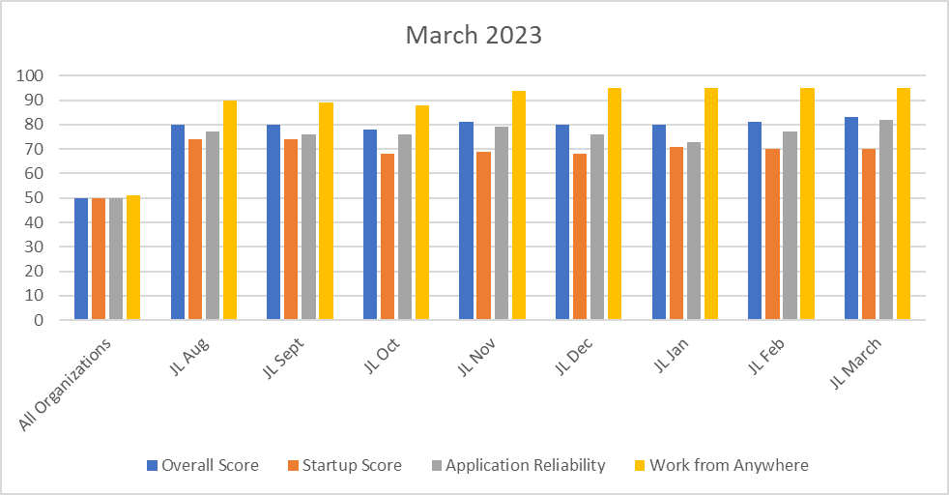
Endpoint Analytics
Overall rose to 84(+1) from February primarily due to increased numbers of Feature Update 22H2 out to our fleet.
App Reliability score rose 82(+5) primarily due to production deployment of 22H2 in March(97% adoption), as well as completion of deployments to production(Egress, Litera, ndOffice).

Slide 34
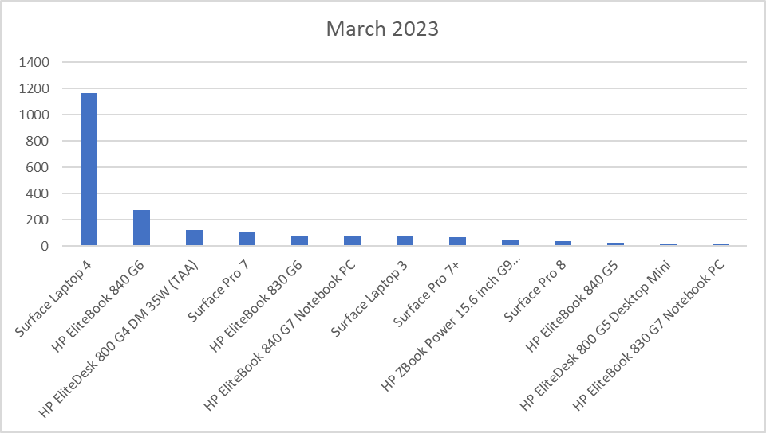
Endpoint Model Inventory
1146 (+20 since February) total Surface Laptop 4s – Best overall performer.
Surface Pro 6 (9 remaining) - Worst performer overall.
HP zBook population is growing(45 overall), providing more horsepower to our more demanding workflows.

Slide 35
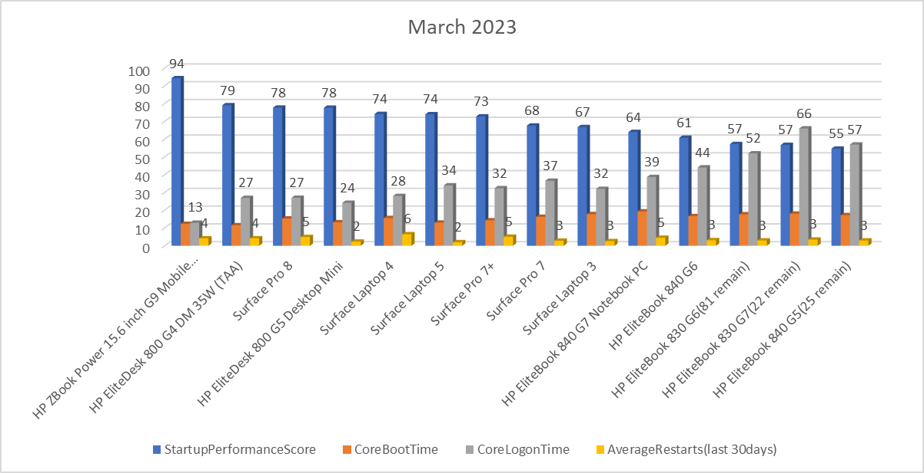
Endpoint Model Performance
Scores improving as older hardware is replaced. Reboots slightly increasing due to new hardware/device updates are available.
2nd worst performer, HP EliteBook G5s with only 32 units remaining(-10 from February) currently being replaced with SLT4/5's by NextGen.

